Slide 1

Renderless parttern in Vue.JS

Slide 2
“How Logic Doesn't Always Need a UI”

Slide 3
Problem

Slide 4
What?
A renderless component is a component that doesn't render any of its own HTML

Slide 5
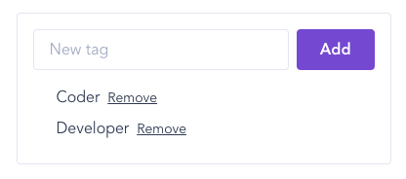
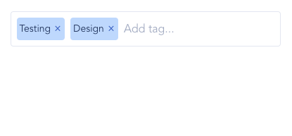
Why?

Slide 6
When?
You're building a library and you want to make it easy for users to customize how your component looks
You have multiple components in your project with very similar behavior but different layouts

Slide 7


Thanks
thaycacac
thaycacac

